Slide 1
SWEN90016 Software Processes & Project Management
Cost Estimation
2019 – Semester 1
Tutorial 6
Copyright University of Melbourne 2017

Slide 2
Today’s aim
Become familiar with
Agile
User Stories and Story Points and Velocity
Formal
Function Point Analysis and COCOMO II

Slide 3
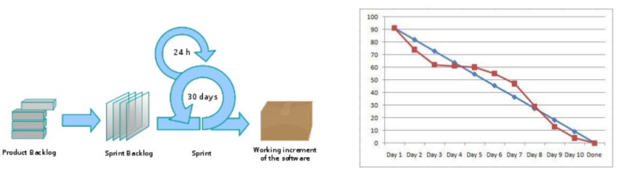
Scrum Overview
From Tutorial 3, slide 11
From Lecture 2, slide 49
Roles
Product Owner
Scrum Master
Development Team
Ceremonies
Daily Stand Up
Sprint Planning
Sprint Review
Sprint Retrospective
Artifacts
User Story
Product Backlog
Sprint Backlog
Burndown Chart
Burnup Chart
From Lecture 2, slide 51
Notes:
Revision of Agile

Slide 4
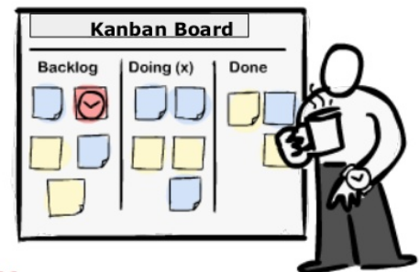
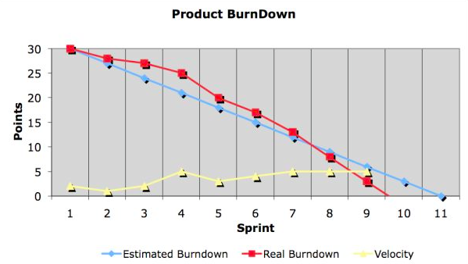
Scrum Artifacts Overview
User Stories
As a <user>, I want < goal> so that < reason>.
Product Backlog
Features listed in client priority order
Release milestones annotated to list
Sprint Backlog
Features selected for this iteration
Visual Kanban board
Burn Down Chart
Measure the features 100% done

Slide 5
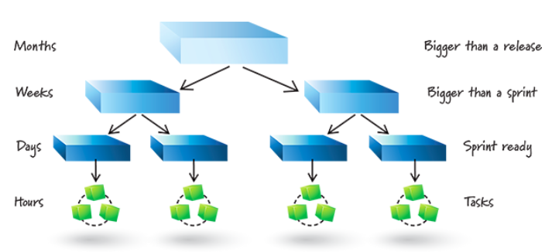
User Story: revision
From Tutorial 3, slide 9
Product Owner has a conversation with the Developer to understand requirement

Slide 6
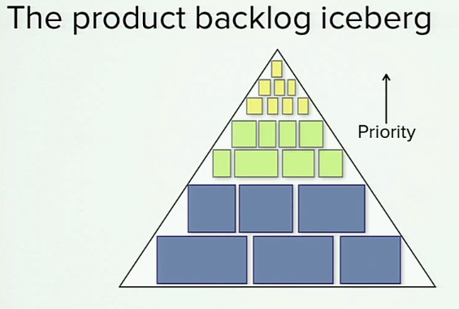
User Story Size
Contentious! Advice from the internet may vary …
(Sprint) User Story
A developer’s perspective
A conversation placeholder
Feature User Story
Product capabilities
Product Owner perspective
Epic User Story
New business services
A product

Slide 7
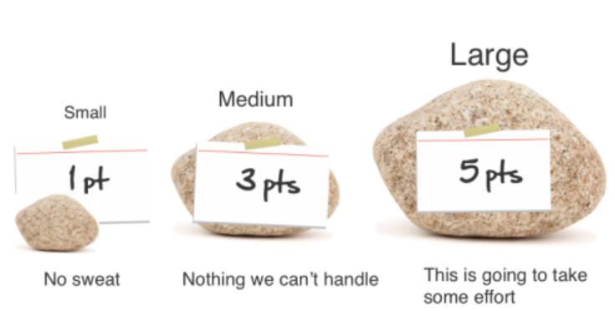
User Story Effort Estimation
Story points: a relative measure of the size of a user story
(the requirements of the system are documented using user stories)
From Lecture 6, slide 71
raw values are unimportant
relative values matter
2 point story is twice as long as a 1 point story
limit range of Sprint Backlog estimates to 1-10

Slide 8
User Story Effort Estimation
A practical Example of Size vs Duration
I am tasked with moving a large pile of dirt from the front of my home to the back yard.
I could look at the pile of dirt, assess my tools [a shovel and a wheelbarrow], and directly estimate the job at two hours.
In arriving at this estimate I bypassed any estimate of size and went directly to an estimate of duration.

Slide 9
User Story Effort Estimation
A practical Example of Size vs Duration
Suppose instead that I look at the pile and estimate its size.
Based on its dimensions I estimate the pile to contain about 100 cubic meters of dirt. This is my estimate of the size of this project.
We want to know how long it will take to move the dirt: Duration
We need to convert the estimate of size [100 cubic meters] into an estimate of duration.
A label on my wheelbarrow says it has a capacity of two cubic meters.
Dividing 100 cubic meters by 2 cubic meter, I decide that moving the dirt will take 50 trips with the wheelbarrow.
I estimate that each trip will take three minutes to load the wheelbarrow, two minutes to walk to the back yard and dump the dirt, and one minute to walk back with the empty wheelbarrow. Total trip time will be six minutes.
Since I anticipate making 50 trips taking 6 minutes each, my estimate of duration is 300 minutes or 5 hours.

Slide 10
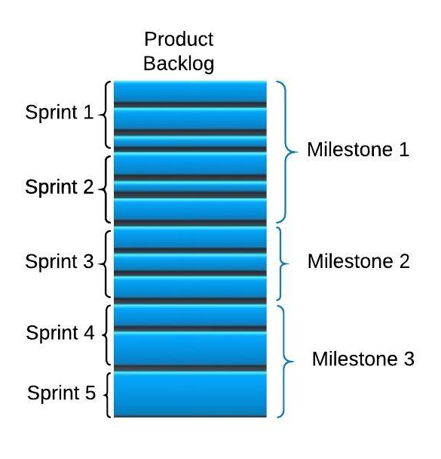
Scrum Release Planning
Project: phase Initiation
Fixed Date and Time constraints
Business Roadmap identifies candidate project
Product vision established with external stakeholders
Create Product Backlog

Slide 11
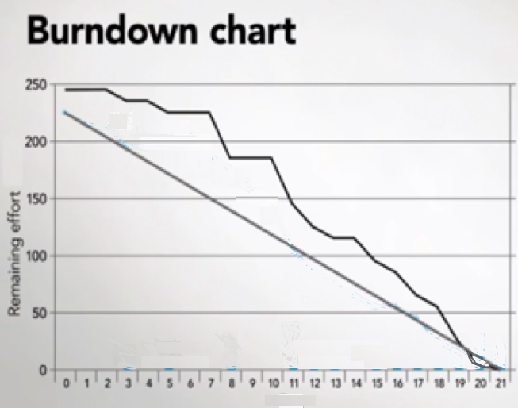
Scrum Release Planning
The groomed Product Backlog is estimated in Story Points
Cheap & quick estimation
Low quality indicators of {easy, medium hard}
Let estimates have larger values, like 21 or 100 are valid
Find the dev team’s Story-Point Velocity measure
It determines the release schedule
Project phase:
Initial Sprint Planning
Y-axis: Story Points
X-axis: Sprints

Slide 12
Sprint Planning
Create Sprint Backlog
Select high value User Stories from Product Backlog
Use velocity to fit appropriate number of Story Points
Decompose selected User Stories on Sprint Backlog
Do Just-In-Time detailed estimation
Check number of Story Points will still fit
Detailed high quality estimation
Let estimates have smaller values, like 1 or 10 are valid
Fixed Date and Time constraints
Project phase:
every Sprint Planning
Humans have good judgement across one order of magnitude, but beyond that, humans are unreliable

Slide 13
Sprint Planning
Fixed Scope constraints
Project phase:
every Sprint Planning
The User Stories can be decomposed into tasks,
Optionally estimate tasks in hours
A full task level Sprint Backlog estimated in hours is equivalent to a formal schedule (Gantt)
Less accurate www.scruminc.com/story-points-why-are-they-better-than/
More work www.mountaingoatsoftware.com/agile/scrum/scrum-tools/sprint-backlog

Slide 14
Sprint Monitoring
Fixed Date and Time constraints
Project phase:
Sprint
Sprint Burn-down chart monitors actual velocity
Scrum Master updated chart after daily standup

Slide 15
Agile Scrum Velocity
Fixed Date and Time constraints
Velocity determines the slope of the BurnDown charts
The Scrum Master can track remaining effort
Predict when the release milestones will be reached
Ideal schedule is the straight line
Actual schedule is the jagged line
Y-axis: effort
The height of the chart shows the amount of work remaining
X-axis: time

Slide 16
Burn Down Chart: Activity
Product Backlog
User Story | Story Point
Story_1 | 3
Story_2 | 5
Story_3 | 13
Story_4 | 8
Story_5 | 1
Story_6 | 3
Story_7 | 2
A project has this groomed Product Backlog, consisting of these User Stories which have been estimated to have these Story Points.
An established development team has an average velocity of seven User Story Points per fortnight.
Estimate how many weeks this team will take to deliver?
If the team actually completes the first two User Stories in two weeks, then what is the actual velocity of the team?
If a new User Story with Story Point=1 is added at the start of week 3, then in how many weeks do you estimate this project will take to be delivered now?

Slide 17
Burn Down Chart: Activity
Product Backlog
User Story | Story Point
Story_1 | 3
Story_2 | 5
Story_3 | 13
Story_4 | 8
Story_5 | 1
Story_6 | 3
Story_7 | 2
A project has this groomed Product Backlog, consisting of these User Stories which have been estimated to have these Story Points.
An established development team has an average velocity of seven User Story Points per fortnight.
Will User_Story_3 fit into a single sprint?
What process does Scrum have for completing User_Story_3 ?

Slide 18
Estimation Strategy Overview
Top Down strategy:
Use cost of a previous similar project, size and effort
Source Lines of Code, Function Points, Cocomo
Bottom up strategy:
Estimate individual work items and sum
WBS, Agile Story Points and Velocity
Parametric:
use project characteristics in a mathematical model
NVP, ROI, IRR
PERT: Program Evaluation & Review Technique

Slide 19
Today’s aim
Become familiar with
Agile
User Stories and Story Points and Velocity
Formal
Function Point Analysis and COCOMO II

Slide 20
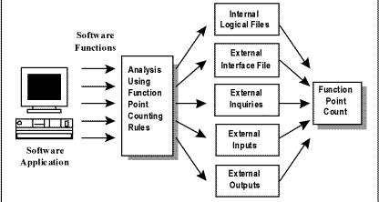
Functional Points
What are they?
PMBOK
Historic Data
Done at any time in project lifecycle

Slide 21
FP Computation Steps
1. Categorize functional requirements and count
Example: Category = {internal file, external file, input, output, query}
Complexity Level = {simple, average, complex}
2. Estimate a Complexity Level for each category
Unadjusted Function Points =
sum (functions * complexity value)
3. Compute count total of Function Points,
(see next slide)
4. Estimate Value Adjustment Factors
Value Adjustment Factor =
apply expert opinion to your project estimates
5. Compute total function point count
Adjusted Function Points =
multiply business function by VAF

Slide 22
FP Computation Steps
1. Categorize functional requirements and count
Example: Category = {internal file, external file, input, output, query}
Complexity Level = {simple, average, complex}
2. Estimate a Complexity Level for each category
Count functions from the Software Requirements Specification (SRS)
Function
Data
Transaction
Data elements
Record elements
Data elements
File references

Slide 23
Step 2: Set Complexity Values
Historic Data
complexity values
Category | Simple Function Count | Weight | Average Function Count | Weight | Complex Function Count | Weight | Sub total
Internal Logical File | 5 | 3 |  | 4 | 2 | 6
External Interface File` |  | 4 |  | 5 | 1 | 7
External Input | 2 | 3 |  | 4 |  | 6
External Output | 5 | 7 | 2 | 10 | 2 | 15
External Inquiries/Queries | 2 | 5 |  | 7 |  | 10
Unadjusted Total
Factors published from 2,192 recent Function Point projects
http://www.qsm.com/resources/function-point-languages-table

Slide 24
Step 3: Calculate Functional Points
Given the following business functions,
how many Unadjusted Function Points exist?
Fill in the table.
Category | Simple Function Count | Weight | Average Function Count | Weight | Complex Function Count | Weight | Sub total
Internal Logical File | 5 | 3 |  | 4 | 2 | 6
External Interface File` |  | 4 |  | 5 | 1 | 7
External Input | 2 | 3 |  | 4 |  | 6
External Output | 5 | 7 | 2 | 10 | 2 | 15
External Inquiries/Queries | 2 | 5 |  | 7 |  | 10
Unadjusted Total

Slide 25
COCOMO II – another strategy
The Constructive Cost Model:
Here is a playpen to try: http://csse.usc.edu/tools/cocomoii.php
Fill in the details for the Language Research Project.
Extra details to get started: let there be:
Sizing method: 135 Function Points
The Java development language
The cost per person-month is $1500

Slide 26
Thank You!

Slide 27
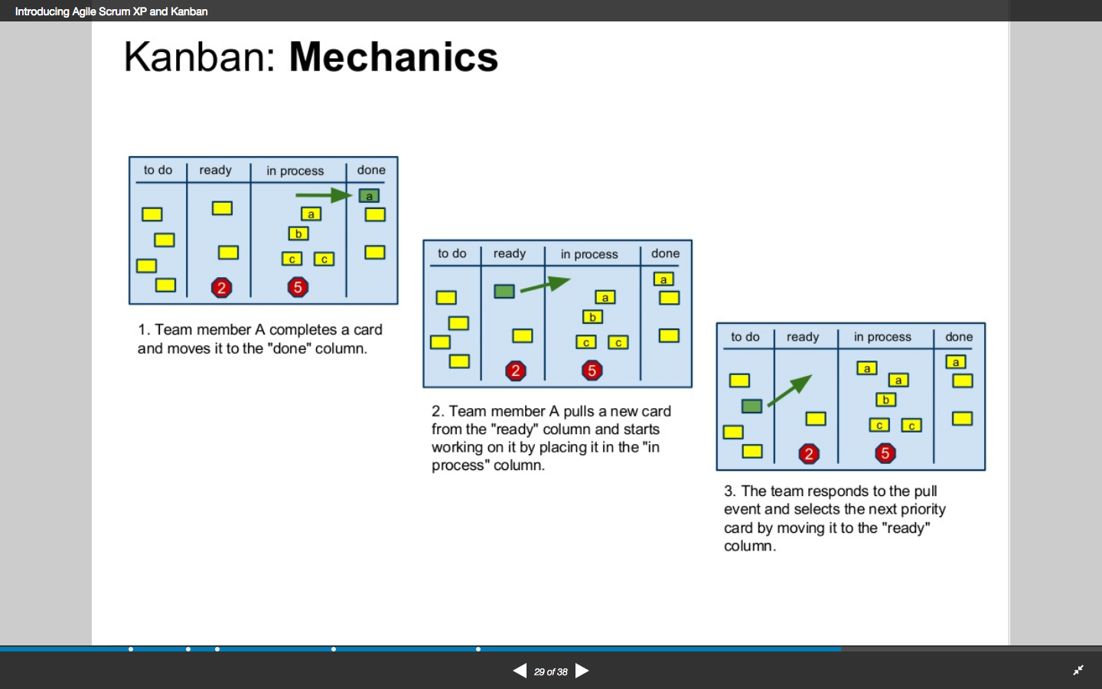
Velocity revision
From Tutorial 6, slide 21
Velocity: velocity is the number of story points “done” by the Scrum development team in a Sprint time period.
Swimlane
Board
Product
Backlog
Sprint
Backlog
Team member A completes code for a card and moves it to “done”
The Product Owner selects the next priority set of cards (Sprint Backlog) and moves it to “ready”
Team member A “pulls” a new card from “ready” and moves it to “doing”

Slide 28
Velocity reference material
Description of how to estimate initial velocity
www.mountaingoatsoftware.com/blog/how-to-estimate-velocity-as-an-agile-consultant
Description of User Stories which gave been decomposed into tasks and estimated in hours,
This optional slows down the productivity of the team,
www.mountaingoatsoftware.com/agile/scrum/scrum-tools/sprint-backlog
Research which assets Story Points are more accurate than hours,
www.scruminc.com/story-points-why-are-they-better-than/
“Story Points are considered faster, better, and cheaper than hours and the highest performing teams completely abandon any hourly estimation as they view it as waste that just slows them down.”

